Slide 1
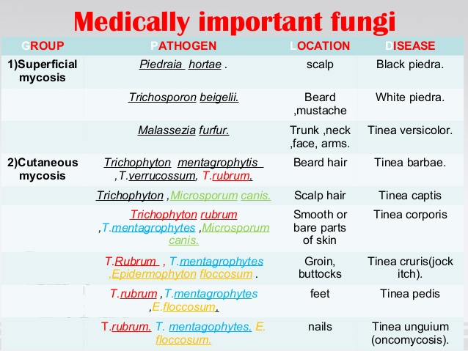

Slide 2
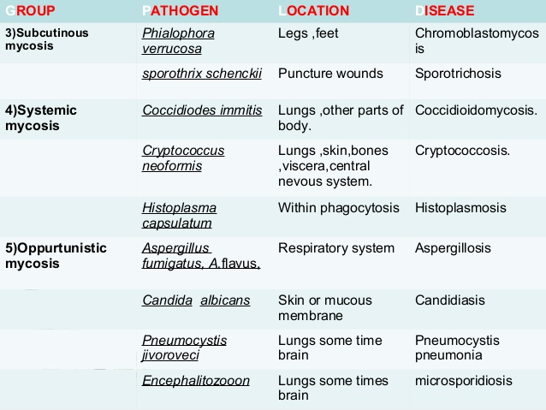

Slide 3
Fungal infection
To establish or confirm the diagnosis of a fungal infection, skin, hair and nail tissue is collected for microscopy and culture (mycology).
Exposing the site to long-wavelength ultraviolet radiation (Wood lamp) can help identify some fungal infections of hair (tinea capitis) because the infected hair fluoresces green.

Slide 4
Direct microscopy of skin scrapings and nail clippings
The material is examined by microscopy by one or more of these methods:
Potassium hydroxide (KOH) preparation, stained with blue or black ink
Fluorescent staining
Unstained wet-mount
Stained dried smear
Histopathology of biopsy with special stains, eg, periodic acid-Schiff (PAS).
Microscopy can identify a dermatophyte by the presence of:
Fungal hyphae (branched filaments) making up a mycelium
Arthrospores (broken-off spores)
Arthroconidia (specialised external spores)
Spores inside a hair (endothrix) or outside a hair (ectothrix).
Fungal elements are sometimes difficult to find, especially if the tissue is very inflamed, so a negative result does not rule out fungal infection.

